Slide 1

Synthetic Generation flow diagram
Rockyview Geoservices

Slide 2
Goal
Create a program that generates synthetic data from well data

Slide 3
Phase 1 – Creating App to analyze synthetic response based on well data

Slide 4
Section 1.1 – Initializing the Program

Slide 5
Program Initialization
Create a GUI Using Qt Designer
Using Python – connect initialization of GUI when program is started
Requirements:
Load well data button
Loaded well data name
Three dropdown menus to select tracks
Three tracks for well data
Track for synthetic data
Button to create a synthetic data

Slide 6
Qt Layout of main window – 1 well only
Synthetic Analysis
Load Data
Generate Synthetic
Load Seismic
Track 1
Track 2
Track 3
Synthetic Trace
Well Name
Track 1
Track 2
Track 3
Synthetic Trace

Slide 7
Qt layout for synthetic generation window- popup
Drop down dialog button will appear asking for type of available wavelet method to generate synthetic trace via convolution
Wavelet Type
Please Choose a Wavelet Type

Slide 8
Synthetic Generation window – Ricker Wavelet – Qt design
Must have:
Have an option to define a wavelet dominant frequency
Wavelength length
Done button – this button will automatically plot the generated synthetic trace along with time
Ricker Wavelet
Frequency (Hz)
20
Wavelength length (s)
0.5
Sample rate (ms)
2
Done

Slide 9
Load Data Screen
Data Loader
File Location
File location
File Location Button
This will grab the address of the LAS file
Manually/automatically fill text in location
Unit Conversion Section
Sonic log
Density log
Log information (may be able to acquire automatically)
Log start ___ - units ___
KB ___ - units ___
Replacement velocity ___ m/s
Each Section opens from top to bottom
Units Specification/Conversion – Sonic and Density
Sonic Log
Density Log
Log Information
Log Start (m)
KB (m)
Replacement vel. (m/s)
Load

Slide 10
Section 1.2 – Initializing the Program – python

Slide 11
Python Initialization
Create Code that initializes the main window created in Qt
For each of the following button – open appropriate popup windows
Load Data
Synthetic Generation
Must first check if there is a current LAS file loaded into memory
Type of synthetic wavelet to be created
Window for option for the current selected synthetic wavelet

Slide 12
Section 1.3 – Loading Data

Slide 13
Loading Data
When Load Well button is clicked –
Have prompt pop up to acquire location of LAS well file
Load well file into memory
Determine well name – to be later displayed once stored
Determine all available well data
For each well data, store data into memory – dictionaries may be useful but library ‘welly’ may have a tool already for this
Ask user for data conversion for following:
Sonic log – s/m?? - optional
density - optional
Log start ___ - units ___ - from welly (min from data)
KB ___ - units ___ - from welly
Seismic datum -> SD-KB+log_start = distance below seismic datum
Depth/replacement velocity = log start time
Replacement velocity ___ m/s

Slide 14
Loading Data
Automatically Calculate/Data Preparation: (notes taken from synthetic_seismogram github)
Log start time -> in data itself
Replace Nan values with zero – dt_interval
Cumulative time
Total two way time
Acoustic impedance
Sonic velocity calculate
Reflection coefficients
Resampling to the time domain and Rc calculation

Slide 15
Section 1.4 – Creating Synthetic Trace from Data

Slide 16
Synthetic generation – Ricker wavelet
On event that the ‘generate synthetic’ button is hit the Qt Widget for synthetic generation will pop-up
Ricker wavelet requirements
Have an option to define a wavelet dominant frequency (use a slider – default f=30Hz)
Wavelength length
Done button – this button will automatically plot the generated synthetic trace along with time

Slide 17
Synthetic Generation – Others
Other wavelets can be used with the use of bruges library
Other types of synthetics will be developed along here as time progresses

Slide 18
Section 1.5 – Plotting Synthetic and Data

Slide 19
Data Loaded into Memory – before/after synthetic is created
Have three dropdown menus to select desired data to be plotted at each track
Well data names can be retrieved from data loading and inserted here for options
For each well data name, connect desired option to the appropriate data in the dataframe
Plot the data into the appropriate window and automatically replace the name of the track at the top and the appropriate legends
Legends
X-label & units
Y-label & units

Slide 20
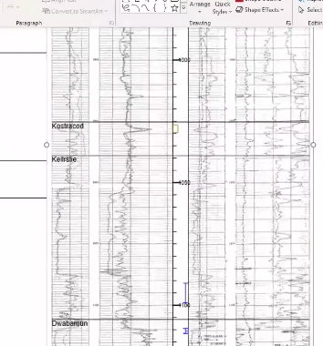
Track s
Gamma track – 1inch
Sonic track – 2 inch
Density Track – 2 inch
Sonic and density track – 2.5inch combined

Slide 21
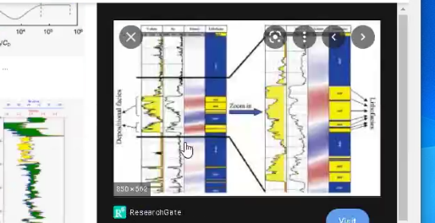
Color fill
Have

Slide 22
Have options to create aliases to select DT

Slide 23
Section 1.6 – Loading Tops and Loading 2 wells

Slide 24
Section 1.7 – Adding an option to apply bulk shift to all data

Slide 25
Section 1.8 – Adding a memory of the data to apply – undo function to any changes in the data

Slide 26
Phase 2 – Program to be able to take in seismic data between wells
Along with synthetic generate trace

Slide 27
Phase 3 - Model trace response given a geological model

Slide 29
